Slide 1
Proteome-wide Screen for RNA-dependent Proteins
non-synchronized A549 cells
DataScience SS21 - Project 3 Group 4
Izar Schärf, Lukas link, Alexandra Kummer, Celina Schenkelberger

Slide 2
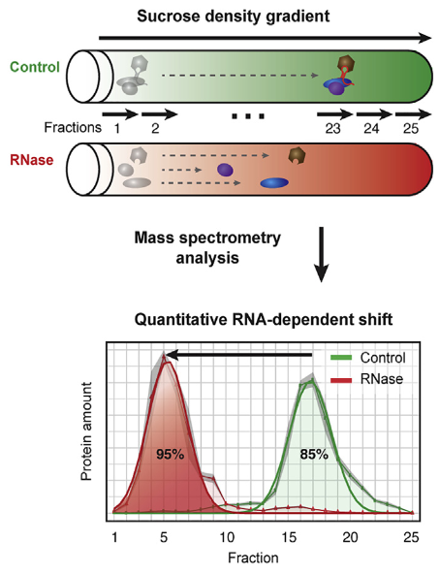
R-DeeP: Proteome-wide Screen for RNA-dependent Proteins
RNA-binding proteins (RBPs) functions: RNA biogenesis, regulation of gene expression, alternative splicing, …
malfunction of RBPs: neurodegenerative disorders, cancer
R-DeeP : proteome-wide, unbiased, and enrichment-free screen, based on density gradient ultracentrifugation
defining a protein as RNA dependent when its interactome depends on RNA
RBPs are expected to migrate to different positions in a sucrose density gradient in the presence or absence of RNA
non-synchronized A549 cells: Human Caucasian lung carcinoma cells
Literature: Caudron-Herger et al., (2019), Molecular Cell 75, 184–199, 2019 Elsevier Inc.

Slide 3
Project goals
End goal is to perform analysis of the mass spectrometry data to automatically identify RNA-dependent proteins
Normalization and cleanup
Identification of maxima
Shift detection/clustering
Definition/Application of selection criteria
Further analysis and evaluation

Slide 4
Dataset
Mass spectrometry data from non-synchronized A549 cells
25 fractions
3 repetitions
3680 human proteins
Human protein | Fraction 1 Rep. 1 Ctlr | Fraction 1 Rep. 1 RNase | Fraction 1 Rep. 2 Ctlr | Fraction 1 Rep. 2 RNase | Fraction 1 Rep. 3 Ctlr | Fraction 1 Rep. 3 RNase | Fraction 2 Rep. 1 Ctlr | … Fraction 25
SPB6_HUMAN | 0.00 | 0.00 | 0.00 | 0.00 | 0.00 | 0.00 | 7370.80
CRYAB_HUMAN | 0.00 | 0.00 | 0.00 | 0.00 | 0.00 | 0.00 | 0.00
VIGLN_HUMAN | 0.00 | 0.00 | 0.00 | 0.00 | 0.00 | 0.00 | 0.00

Slide 5
Restructuring
2 new dataframes (df) (3*3680 x 25) one for the control group and one for the RNase group
Human protein | Fraction 1 | Fraction 2 | Fraction 3 | Fraction 4 | Fraction 5 | Fraction 6 | Fraction 7 | … Fraction 25
SPB6_HUMAN Rep. 1 (Ctlr) | 0.00 | 7370.80 | 72064.00 | 111410.00 | 42962.00 | 2.9982e+04 | 10513.00
SPB6_HUMAN Rep. 2 (Ctlr) | 0.00 | 5419.70 | 63575.00 | 141020.00 | 38578.00 | 1.9908e+03 | 6228.00
SPB6_HUMAN Rep. 3 (Ctlr) | 0.00 | 3599.00 | 45914.00 | 80301.00 | 23125.00 | 1.4686e+04 | 5938.00

Slide 6
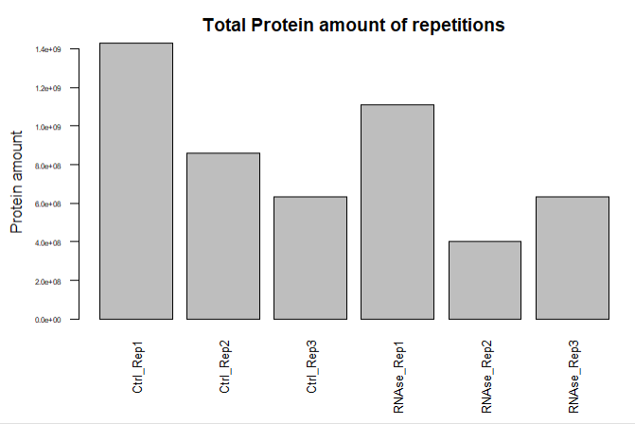
Dataset
Total protein amount of every repetition
Should be about equal for the three repetitions
-> Normalization necessary

Slide 7
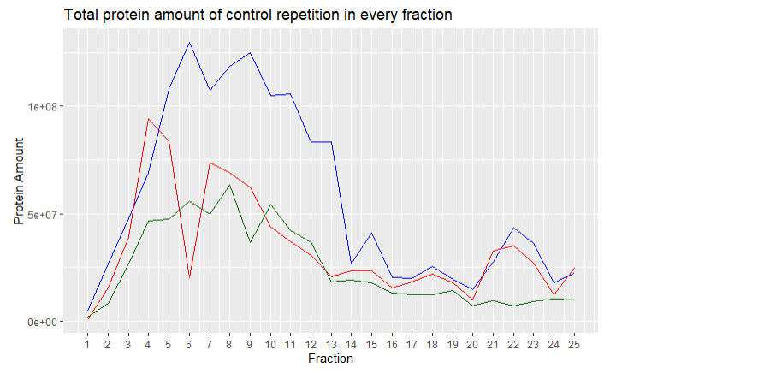
Dataset
Comparison of distribution of control replicates
-> count distribution should be similar
Ctrl_Rep1
Ctrl_Rep2
Ctrl_Rep3

Slide 8
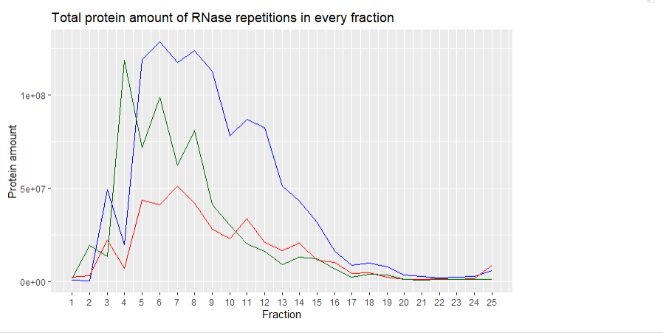
Dataset
Comparison of distribution of RNAse replicates
-> count distribution should be similar
RNase_Rep1
RNase_Rep2
RNase_Rep3

Slide 9
Milestone 1: Normalization
Planned analysis steps:
Calculate total protein sum for each repetition and divide the individual fractions for each protein by this sum.
Show graphics comparing the 3 repetitions to each other post normalization.
Delivers:
2 dataframes (df) (3*3680 x 25) one for the control group and one for the RNase group, with normalized protein amounts.

Slide 10
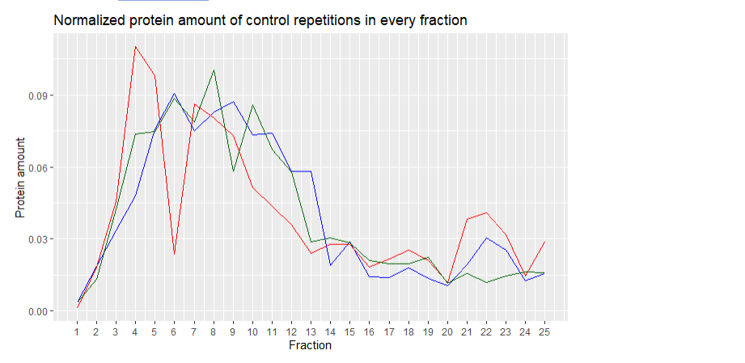
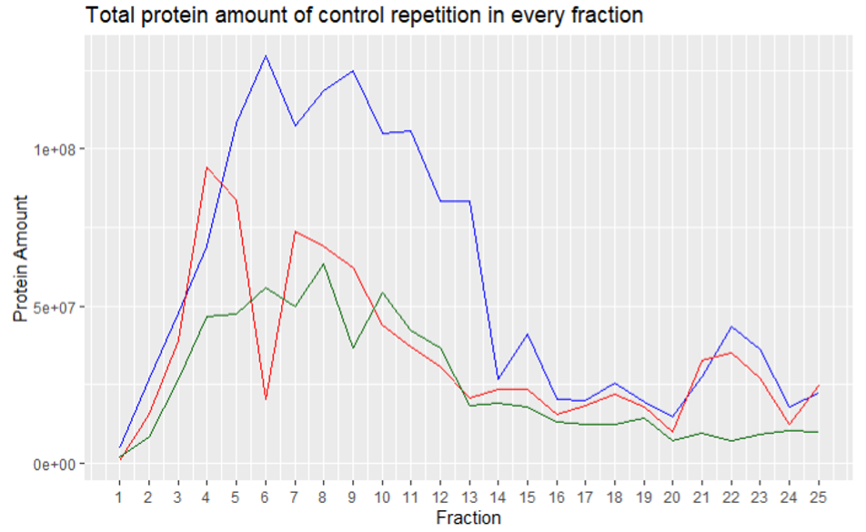
Milestone 1: Normalization
Ctrl_Rep1
Ctrl_Rep2
Ctrl_Rep3

Slide 11
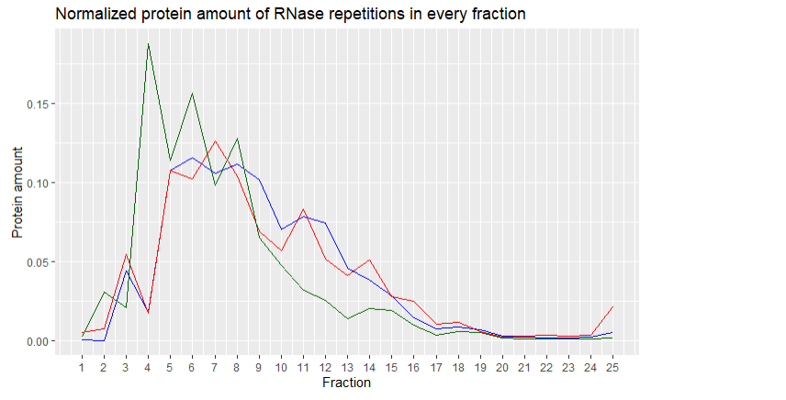
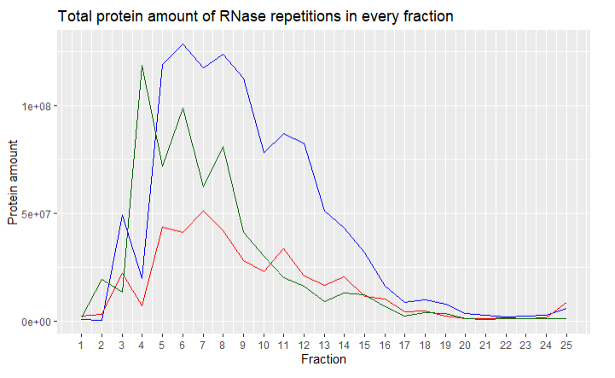
Milestone 1: Normalization
RNase_Rep1
RNase_Rep2
RNase_Rep3

Slide 12
Milestone 2: Cleanup
Planned analysis steps:
Perform the 3 cleanup methods(mean, median, mean with outlier exclusion) so all repetitions are integrated.
Show side by side comparison graphics of the cleanup methods for sample proteins.
Delivers:
6 df (3680x25) for 3 different cleanup methods. - > For each cleanup method one df for the control group and one df for the RNase group without repetitions.

Slide 13
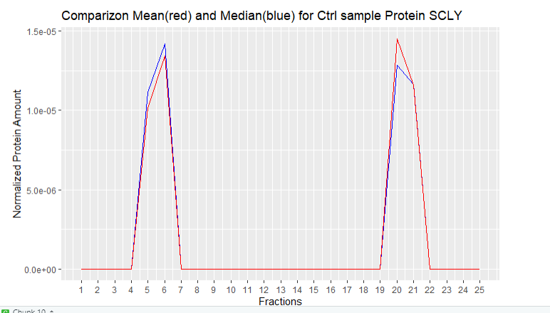
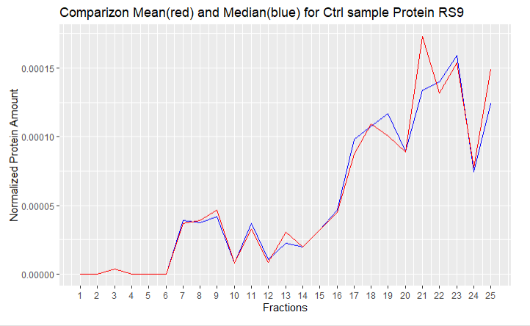
Milestone 2: Cleanup

Slide 14
Milestone 3: Identification of maxima
Planned analysis steps:
Write a method that detects maxima automatically.
Compare method results to graphics of sample proteins.
Adjust method parameters until maxima are accurately detected.
Delivers:
Function which detects maxima.
6 df (3680x?) containing the number and location of the maxima for each protein. - > For each of the three cleanup methods one df for the control group and one df for the RNase group.

Slide 15
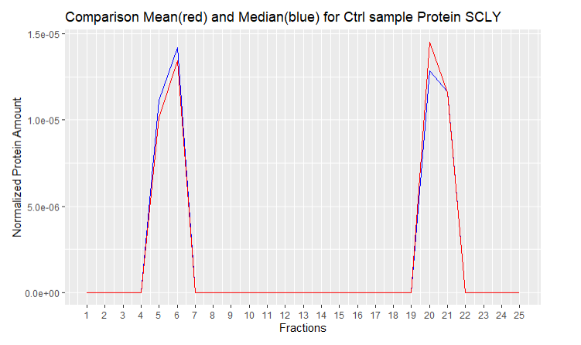
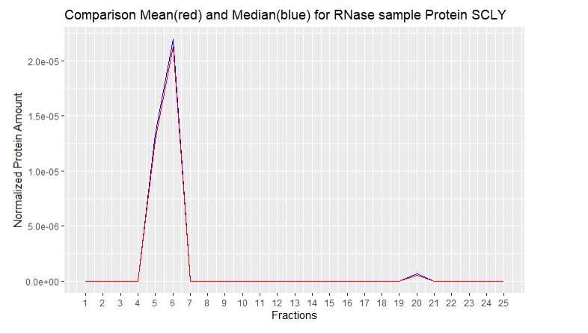
Milestone 4: Shift detection
Control
RNase

Slide 16
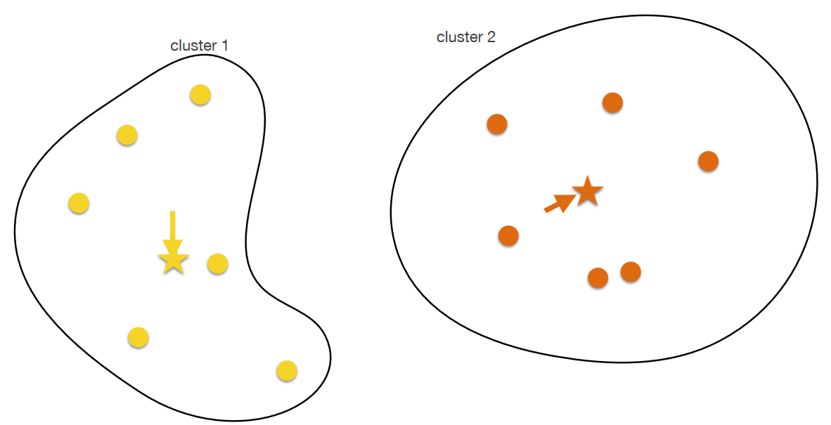
Milestone 4: Shift detection/clustering
Source: Lecture Computer Science Dr. Carl Hermann
Planned analysis steps:
Extract difference in maxima location between control group and RNase group.
Figure out how to handle shifts for multiple maxima within the same protein.
Apply K-means clustering to separate proteins into groups based on their shift characteristics.
Delivers:
3 df (3680x?) containing the shift characteristics of the maxima for each protein.
3 df ( 3680x1) assigning each protein to a cluster.
Graphics showing the clustering of the different proteins.

Slide 17
Milestone 5: Definition/Application of selection criteria
Planned analysis steps:
Define which shift characteristics define RBP (=selection criteria).
Apply selection criteria to the 3 df (statistical test).
Analyze results by comparing the 3 cleanup methods to each other
Classify RBPs according to shift determined in milestone 4
Visualize selected proteins
Delivers:
Potential RBPs classified by shift characteristic
Graphics that visualize shift for selected Proteins

Slide 18
Milestone 6: Further analysis and evaluation
Planned analysis steps:
Get complementary information:
Compare our findings to complementary information from data base
Find most interesting RBPs and get some more information about them
Delivers:
Most interesting RBPs for new discoveries
Confirmed RBPs
Disputed RBPs
Classified as no RBP
RDeep
Data for RBPs and Protein-Protein interactions
RBP2Go
Combined information for gene ontology and RBPs
Uniprot
Information about single Proteins

Slide 19
Timeline
Data cleanup
Maxima detection
Shift detection
RBP identification
Evaluation + Report
19.05 (1 week)
09.06 (3 weeks)
16.06 (1 week)
07.07 (2 weeks)
23.06 (1 week)
Goal:
Automatically detect RBPs and
Find and evaluate new RBP candidates

